Slide 1

Data Visualization Objective 1
David Stevens Feb 2021

Slide 2
Selected DASHBOARD
HR Analytics Dashboard
Executive level dashboard to present current and historical data on the financial, demographic and movement of employees within an organisation.
4 dashboard views with approx. 6 charts per page

Slide 3
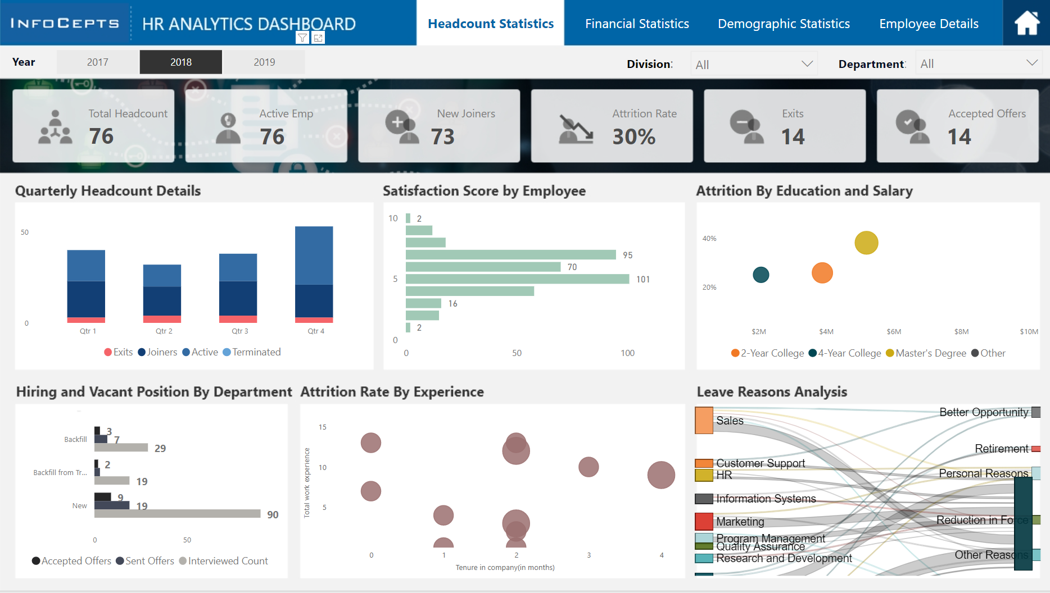
Headcount VIEW
Insight
Does not show any real growth within the company during 2018-2019. (-2 y/y)

Slide 4
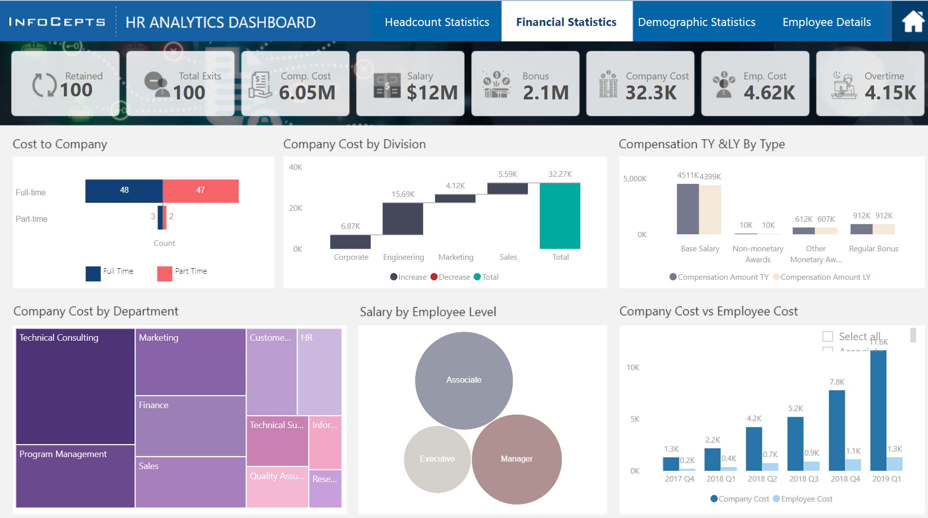
Financial VIEW
Insight
Does not show any real growth within the company during 2018-2019. (-2 y/y)

Slide 5
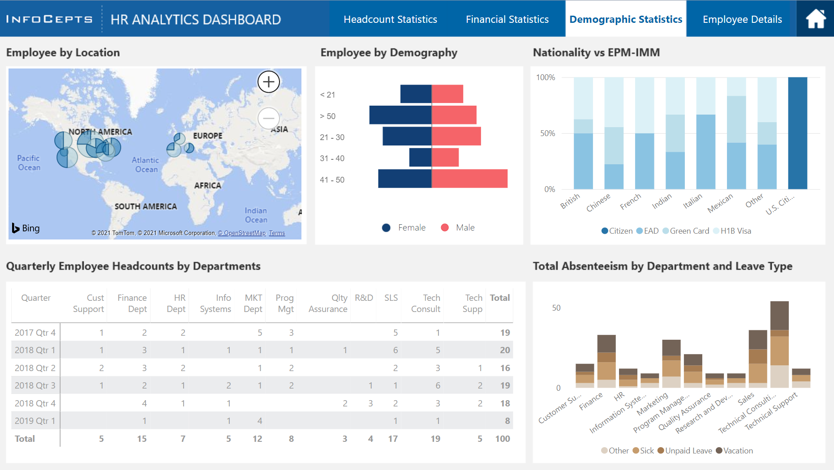
Demographic VIEW
Insight
High absentee rate within Technical Consultancy; would want to investigate the reason behind

Slide 6
RECOMMENDED CHANGES
Consistency The first dashboard presents the headcount statistics for the organisation, with options to select a given year, division or department; this is not carried forward on the other dashboards.
Option to expand an individual viewpoint
Each dashboard page presents a lot of information (approx. 6 charts per page), I would allow users to expand and view a single chart in full screen, ensuring labels and all supporting information can be clearly shown. On a number of the charts axis labels are missing and it assumes the viewer.
Drop the final dashboard - Employee Details
The final dashboard presents a single viewpoint for an employee, this doesn't follow the flow of the other 3 dashboards and should be excluded here and presented separately (within an employees HR profile).

